Slide 1
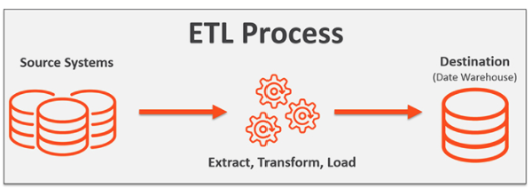
Project 2: ETL
Team:
Karla Flores
Elijah Abuel
Simon Castellanos
Morteza Akbari
Joseph Mills Jr.

Slide 2
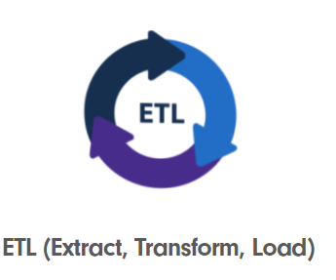
Project 2 Proposal Group 4
Our group (Group #4) are going to extract of the electricity data sets (KwH), weather data for the city of Houston. We are also going to extract the crude oil prices (West Texas Intermediate-(WTI)).
We want to know how the electricity rates are in relationship with the weather changes and oil price fluctuations for the city of Houston.
After execrating the data, we will implement the data transformation by using Python (Jupyter Notebook).
And finally, we will load the new data frames into our database which is PostgreSQL (PgAdmin4)
Team:
Karla Flores
Elijah Abuel
Simon Castellanos
Morteza Akbari
Joseph Mills Jr.

